Slide 1
Detection of Deepfakes Bispectra and Power Bispectra of Tacotron 2 Data
Speech Group 24/04/2024
Anthony White

Slide 2
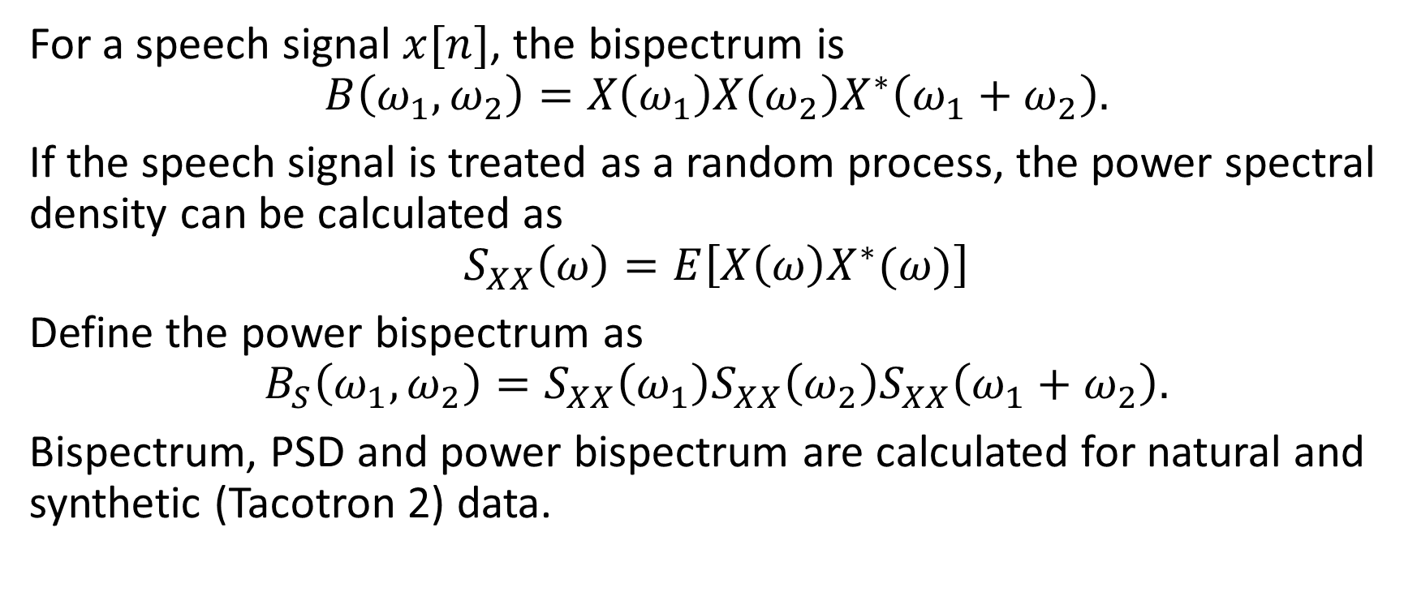
Bispectrum and Power Bispectrum
For a speech signal $x[n]$, the bispectrum is
$$B\left(ω_{1},ω_{2}\right)=X\left(ω_{1}\right)X\left(ω_{2}\right)X^{∗}\left(ω_{1}+ω_{2}\right).$$
If the speech signal is treated as a random process, the power spectral density can be calculated as
$$S_{XX}\left(ω\right)=E\left[X\left(ω\right)X^{∗}(ω)\right]$$
Define the power bispectrum as
$$B_{S}\left(ω_{1},ω_{2}\right)=S_{XX}\left(ω_{1}\right)S_{XX}\left(ω_{2}\right)S_{XX}\left(ω_{1}+ω_{2}\right).$$
Bispectrum, PSD and power bispectrum are calculated for natural and synthetic (Tacotron 2) data.

Slide 3
Nicholas’ Speech (male)

Slide 4
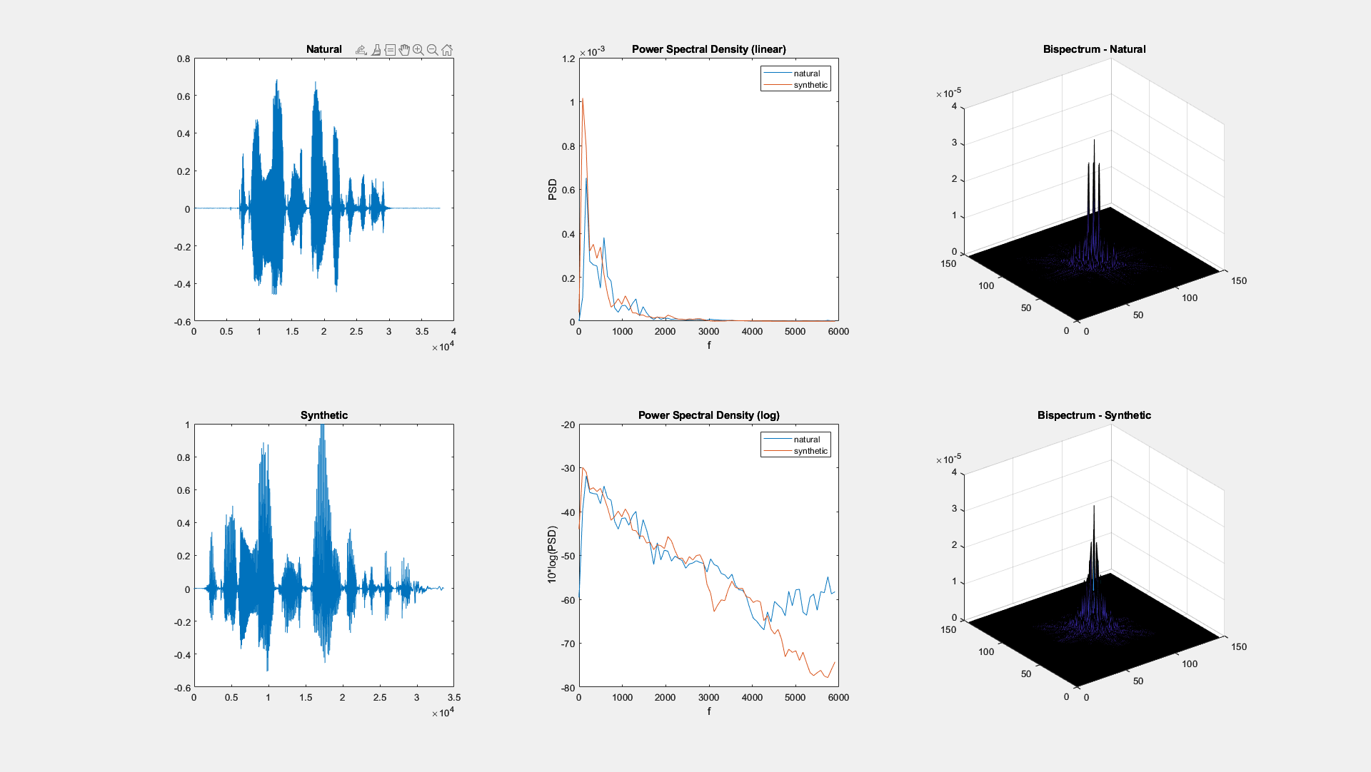

Slide 5
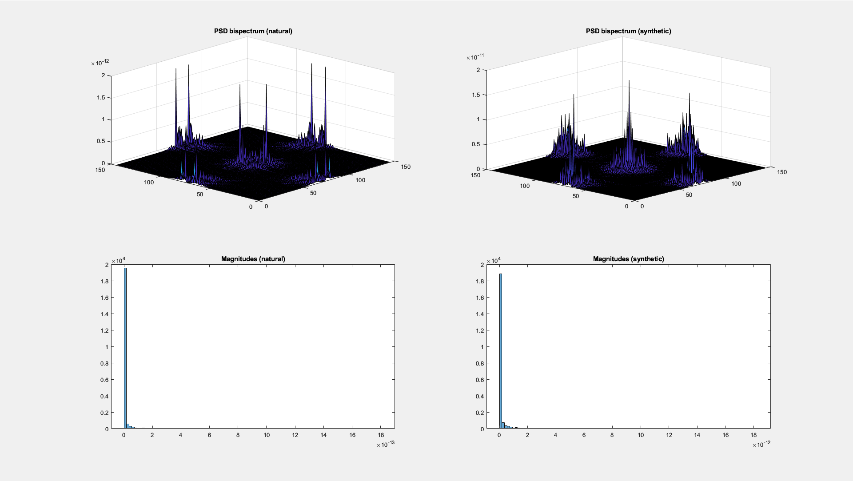

Slide 6
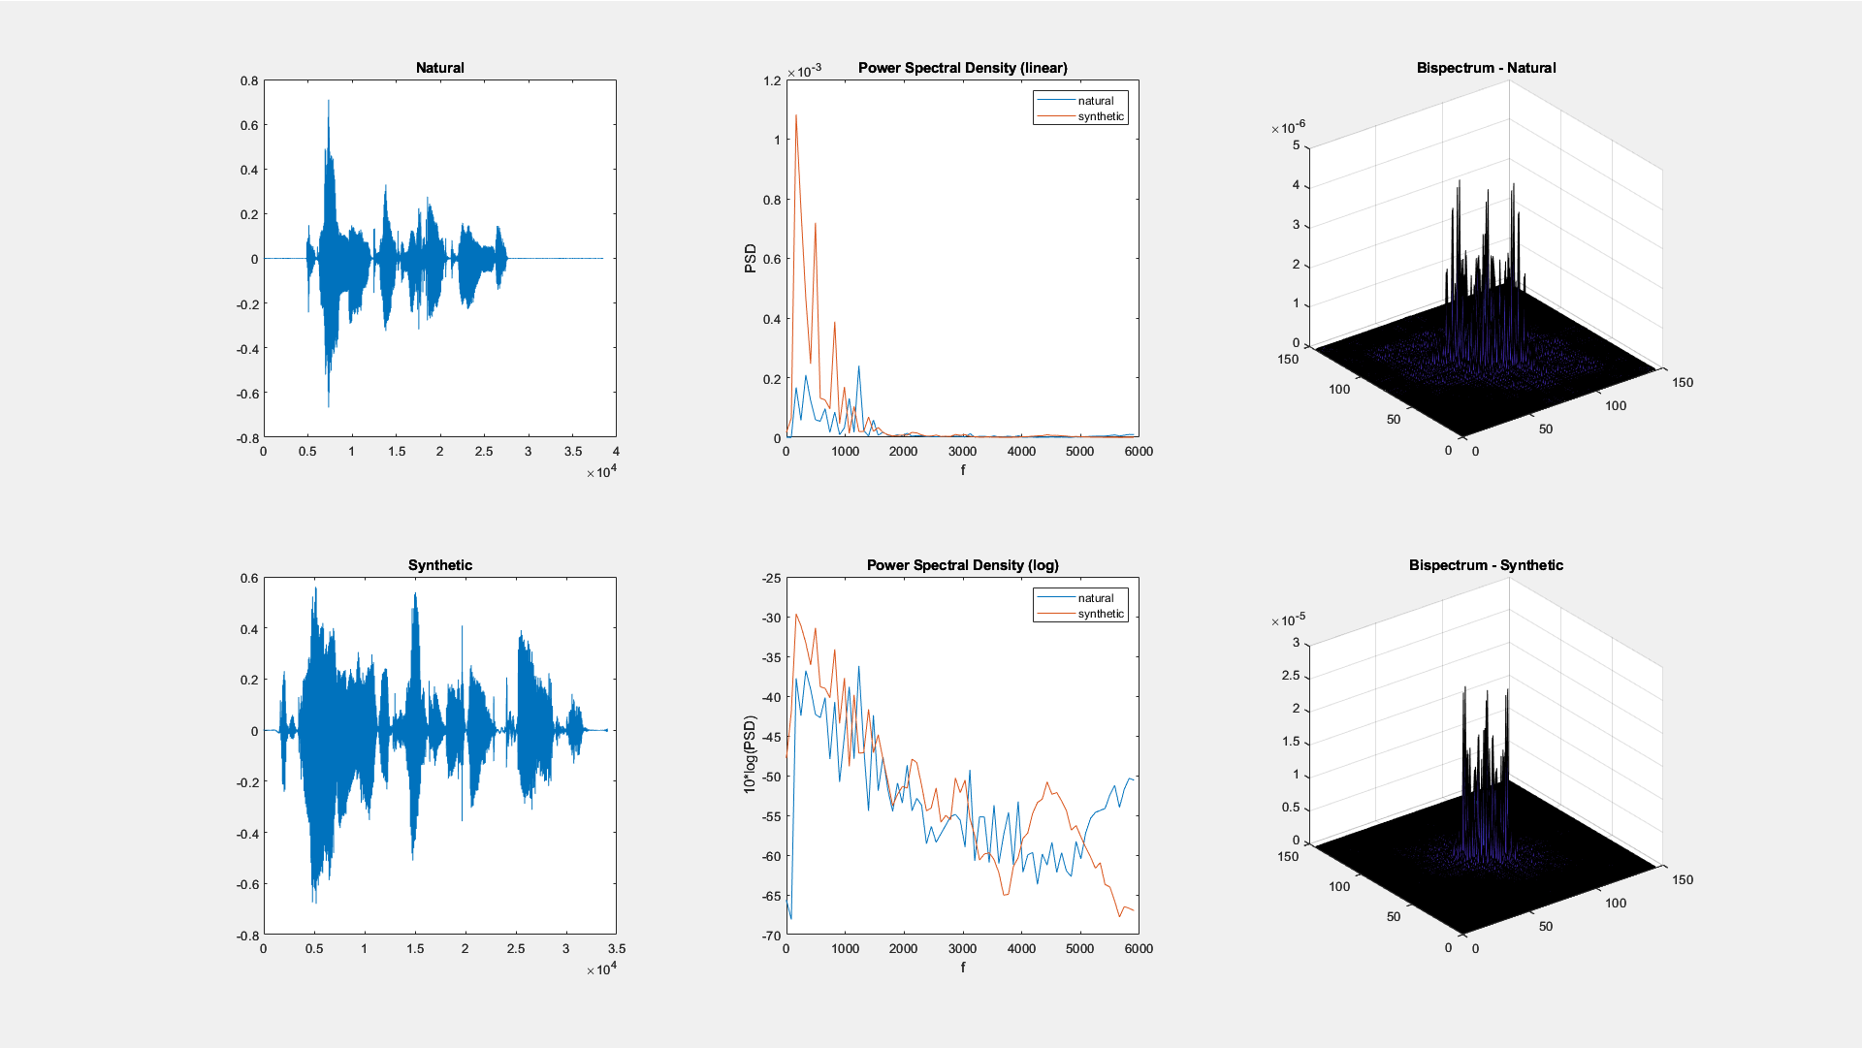

Slide 7
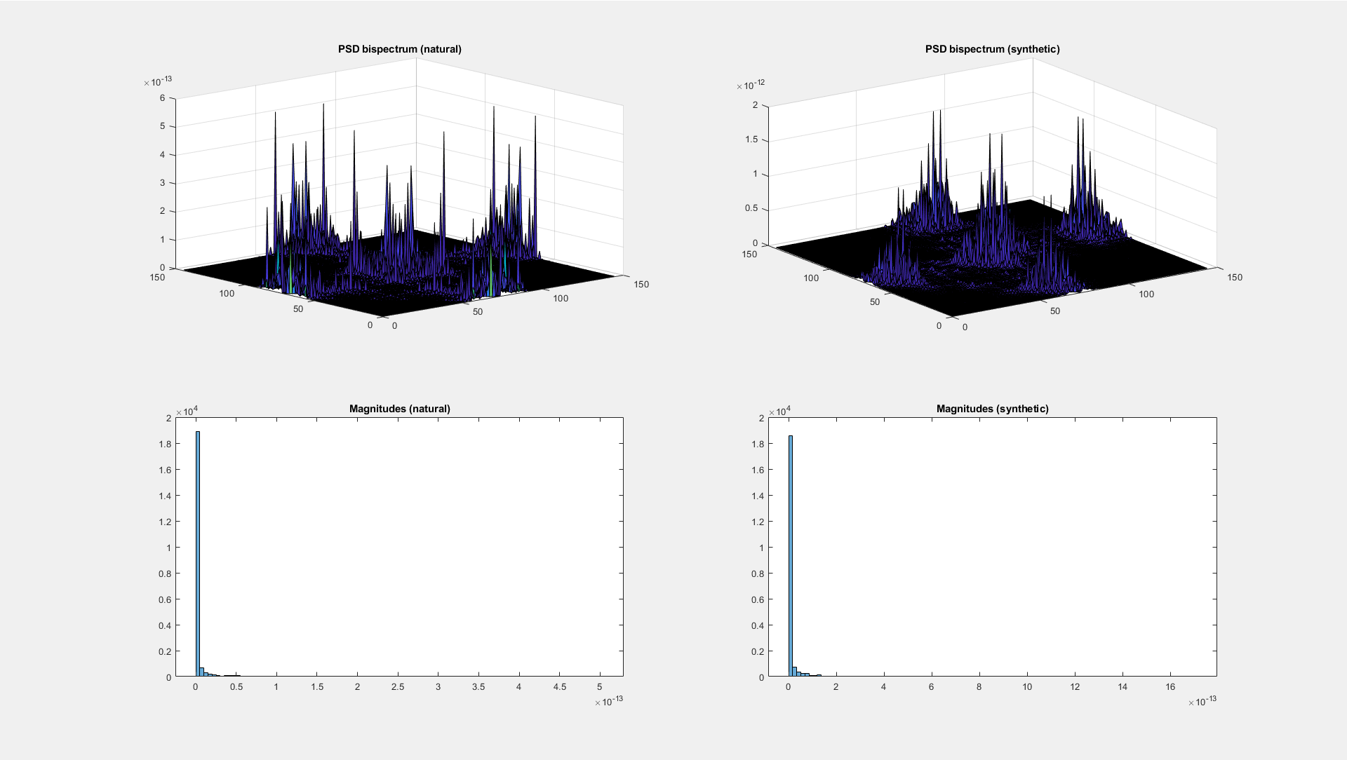

Slide 8
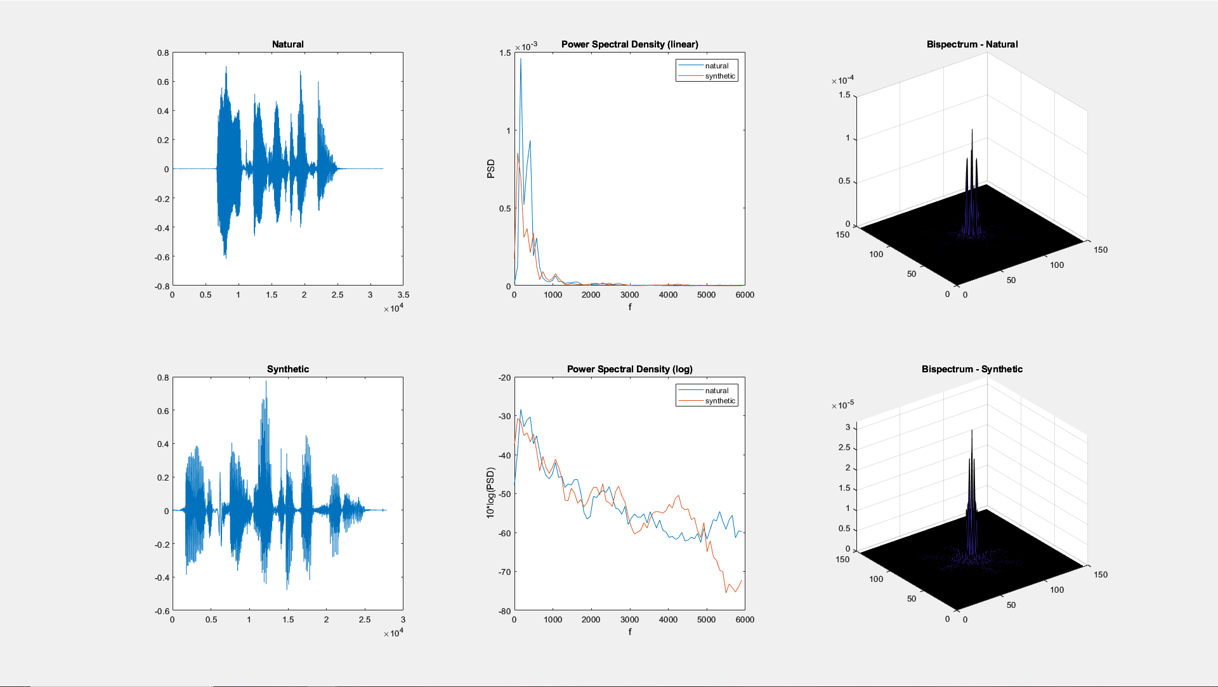

Slide 9
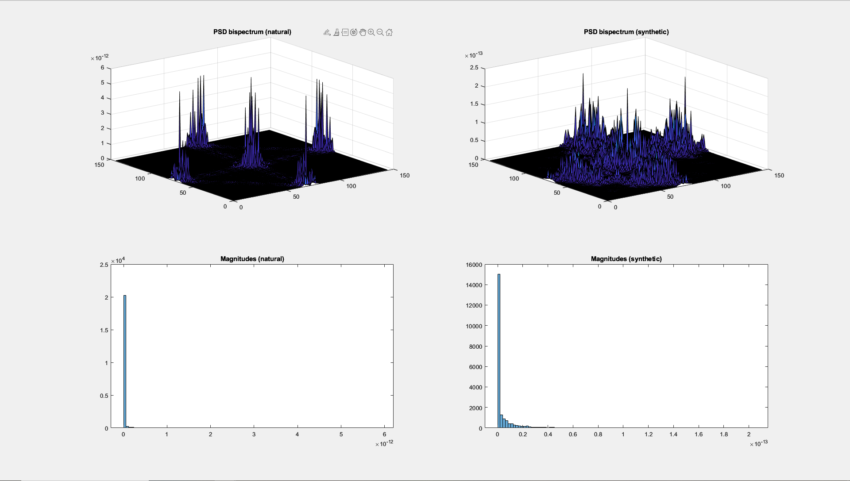

Slide 10
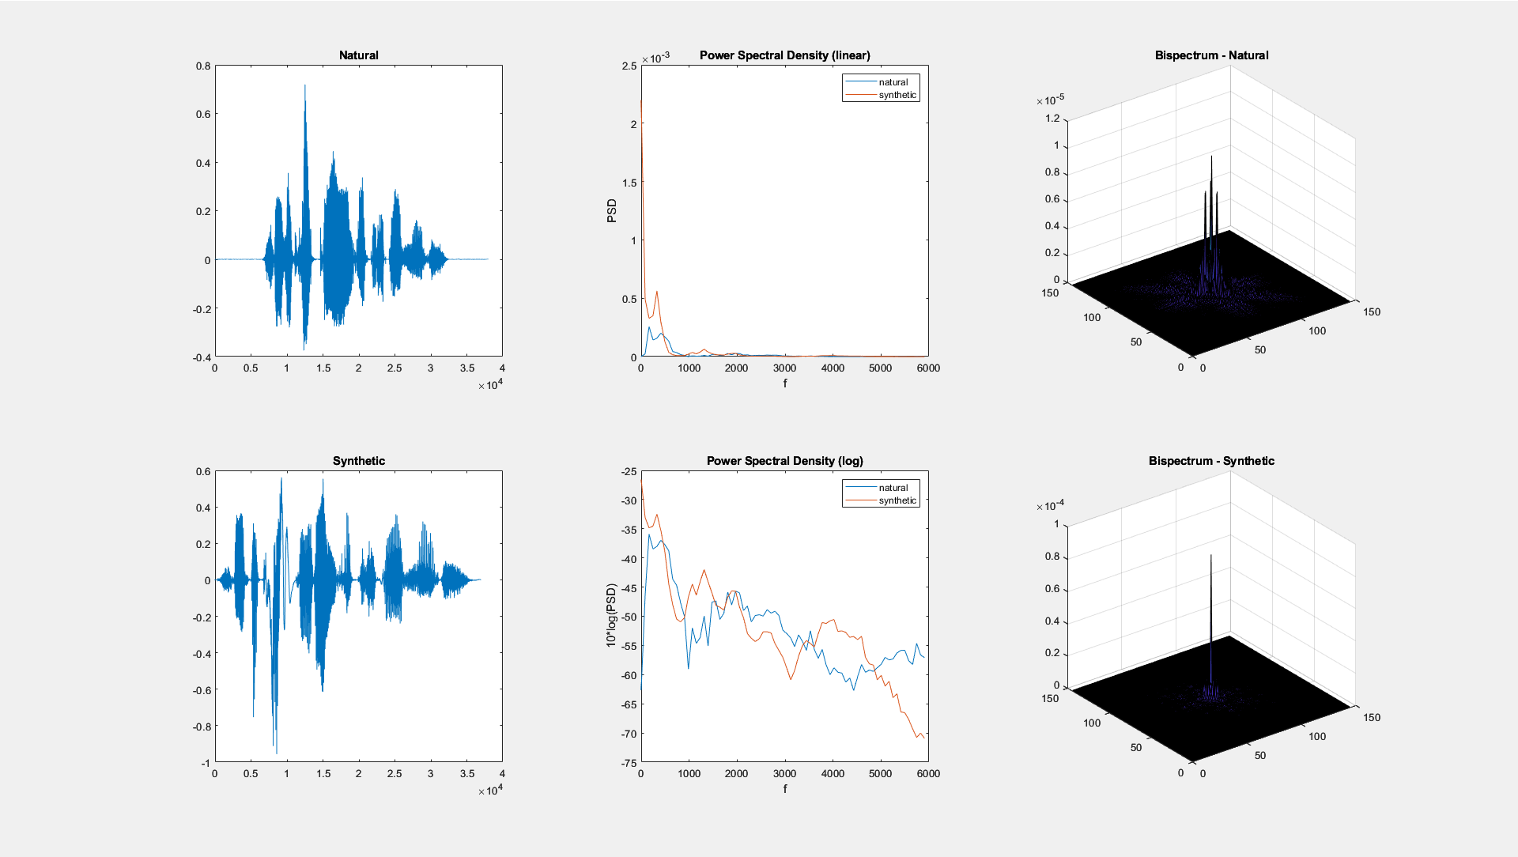

Slide 11
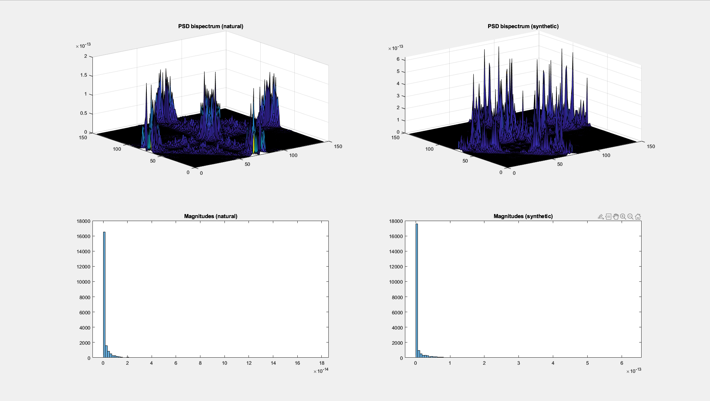

Slide 12
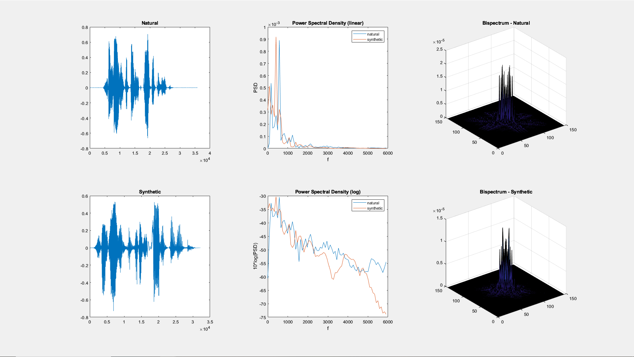

Slide 13
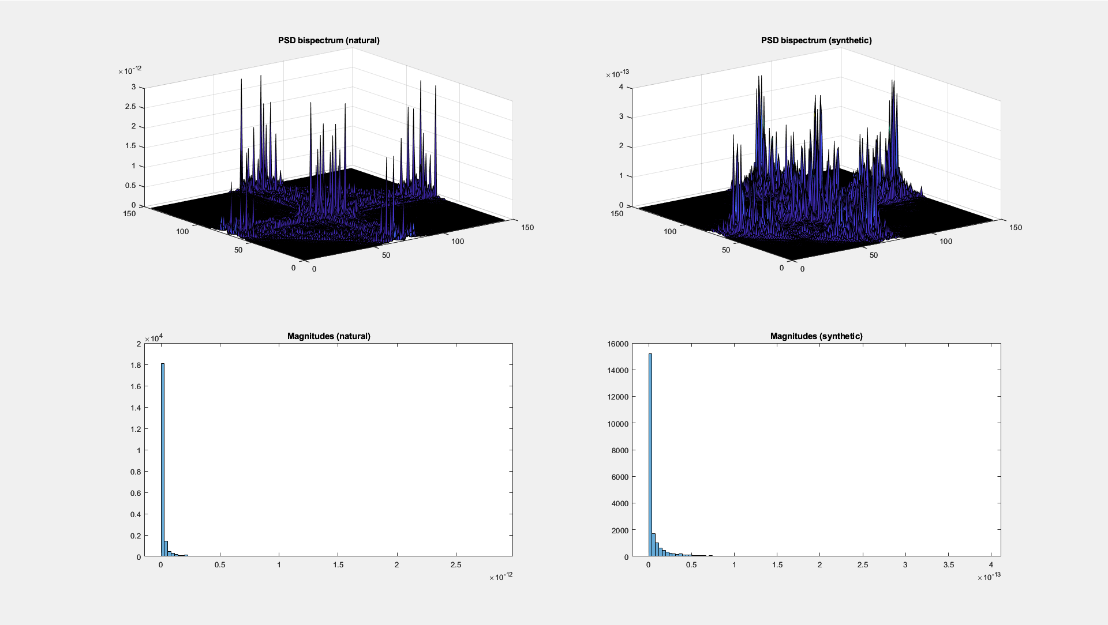

Slide 14
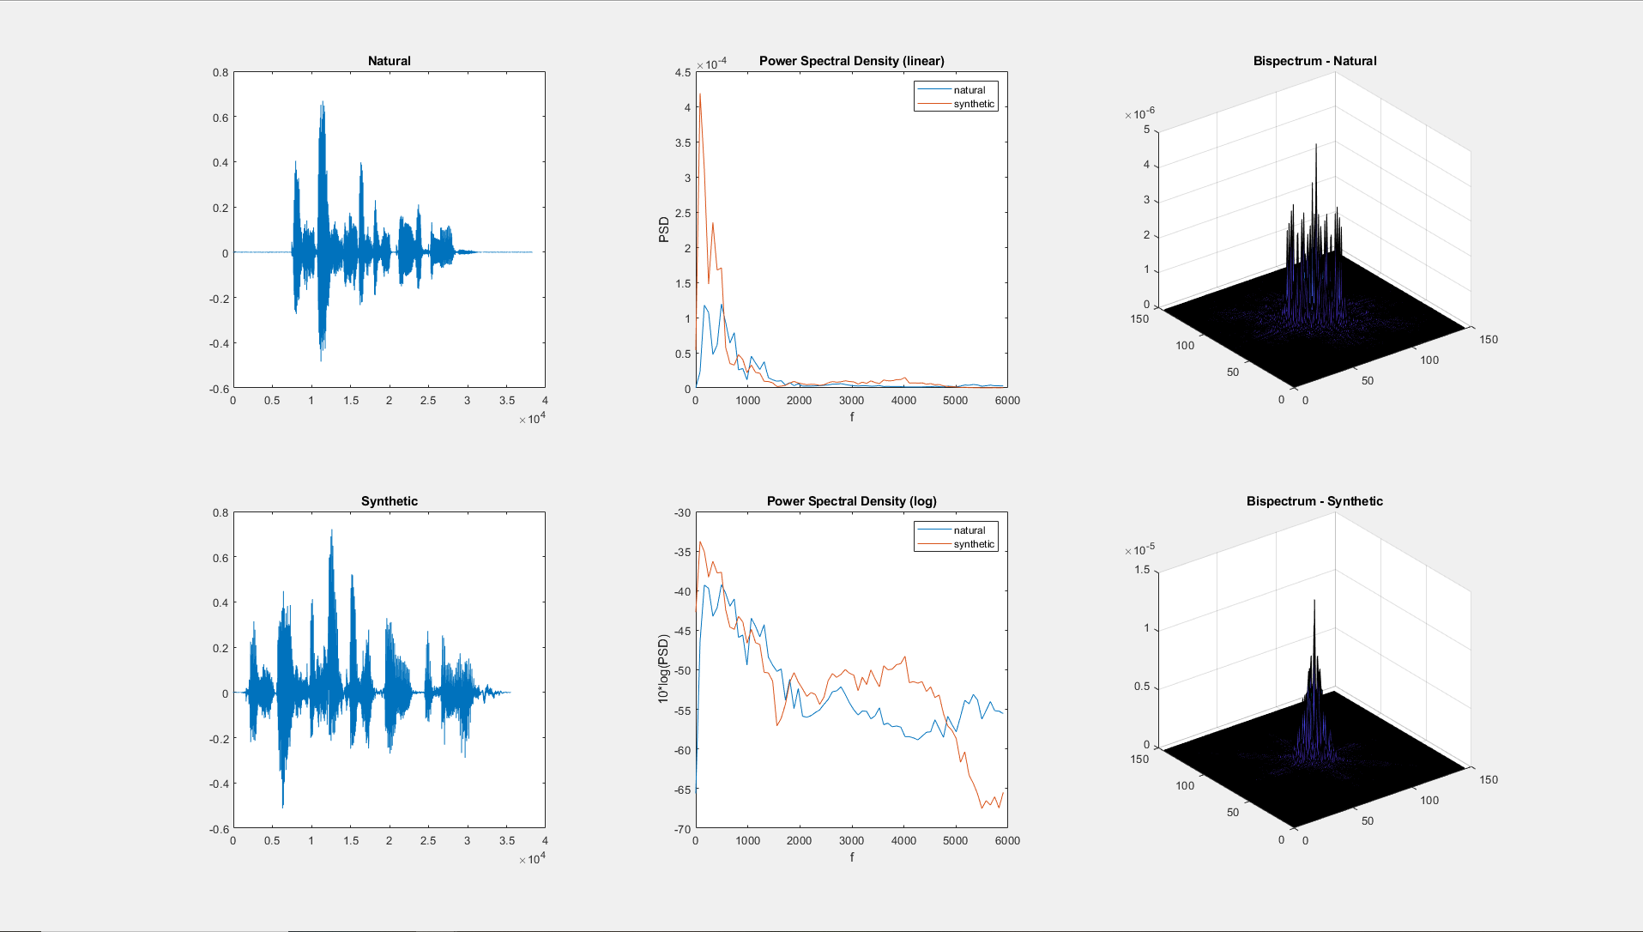

Slide 15
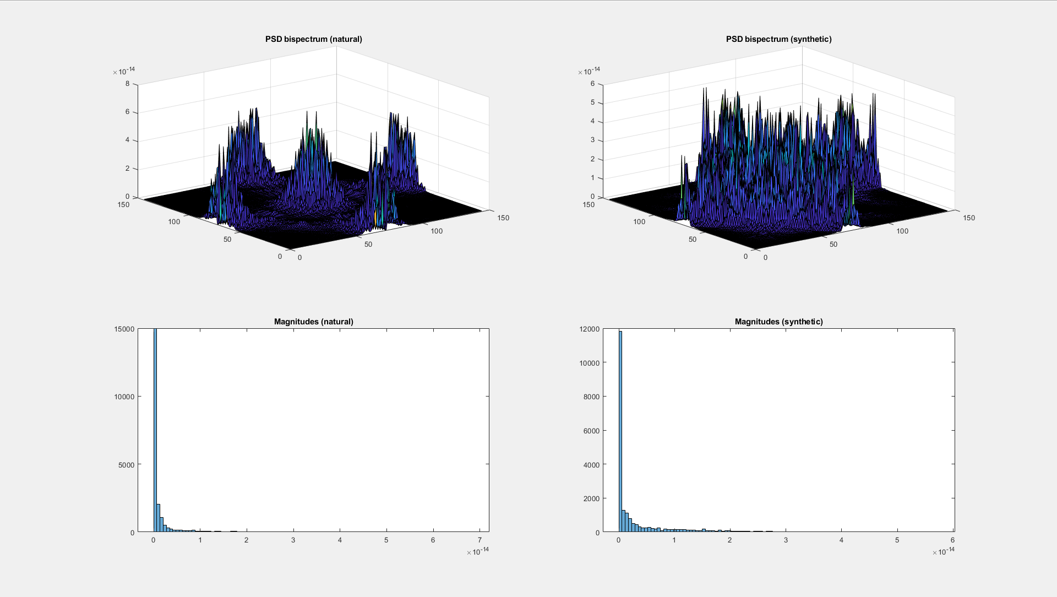

Slide 16
Isabella’s Speech (female)

Slide 17
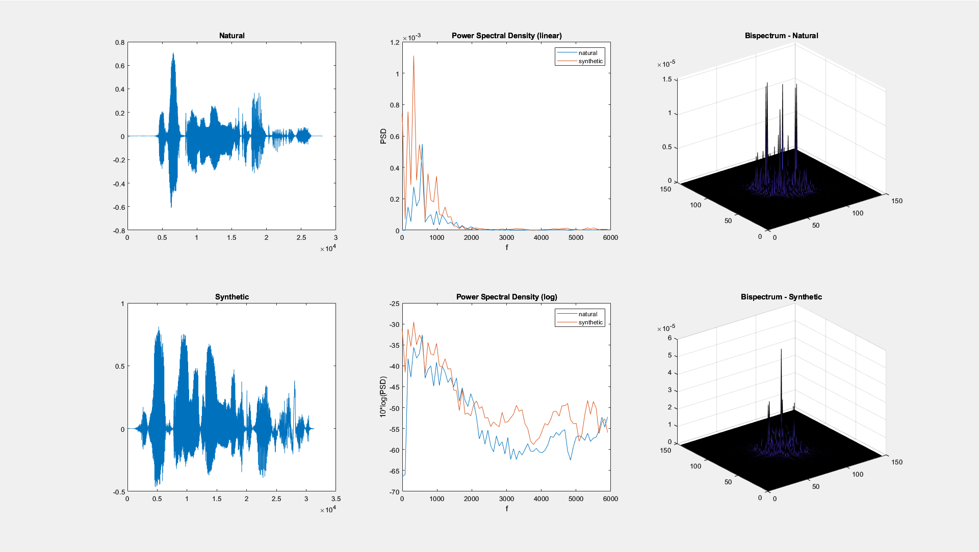

Slide 18


Slide 19


Slide 20


Slide 21
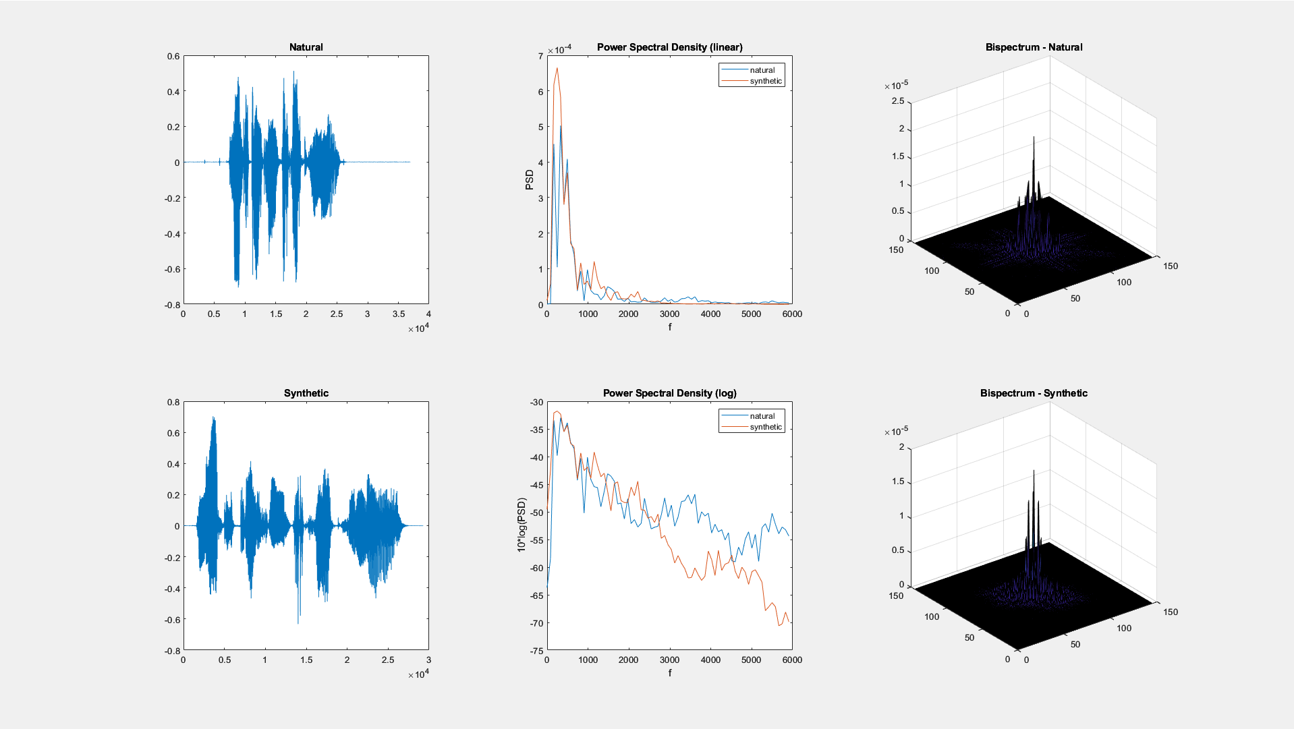

Slide 22
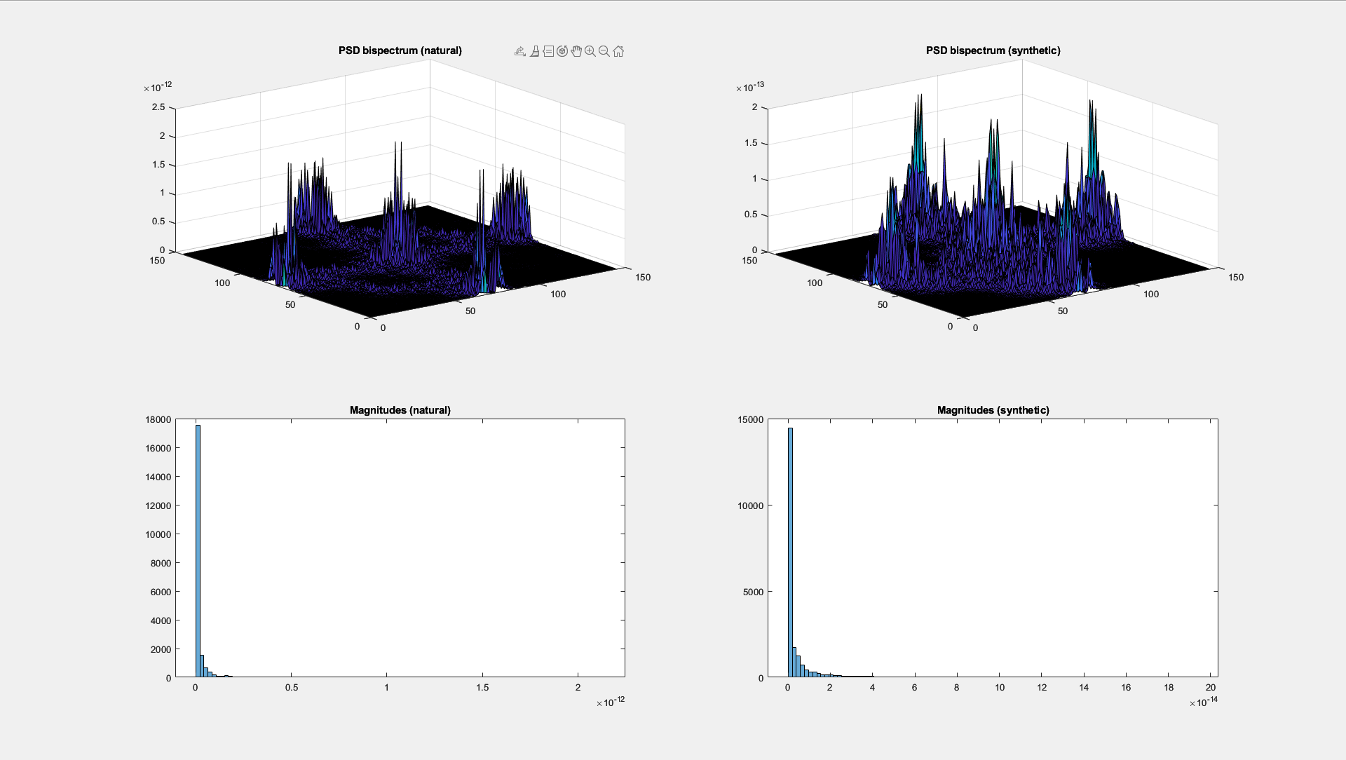

Slide 23
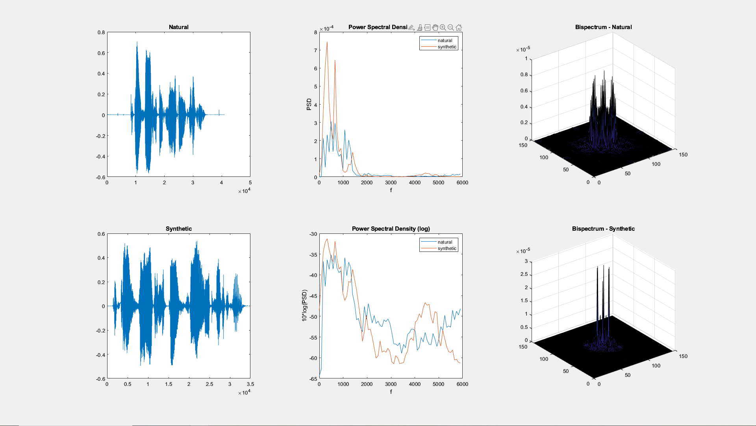

Slide 24
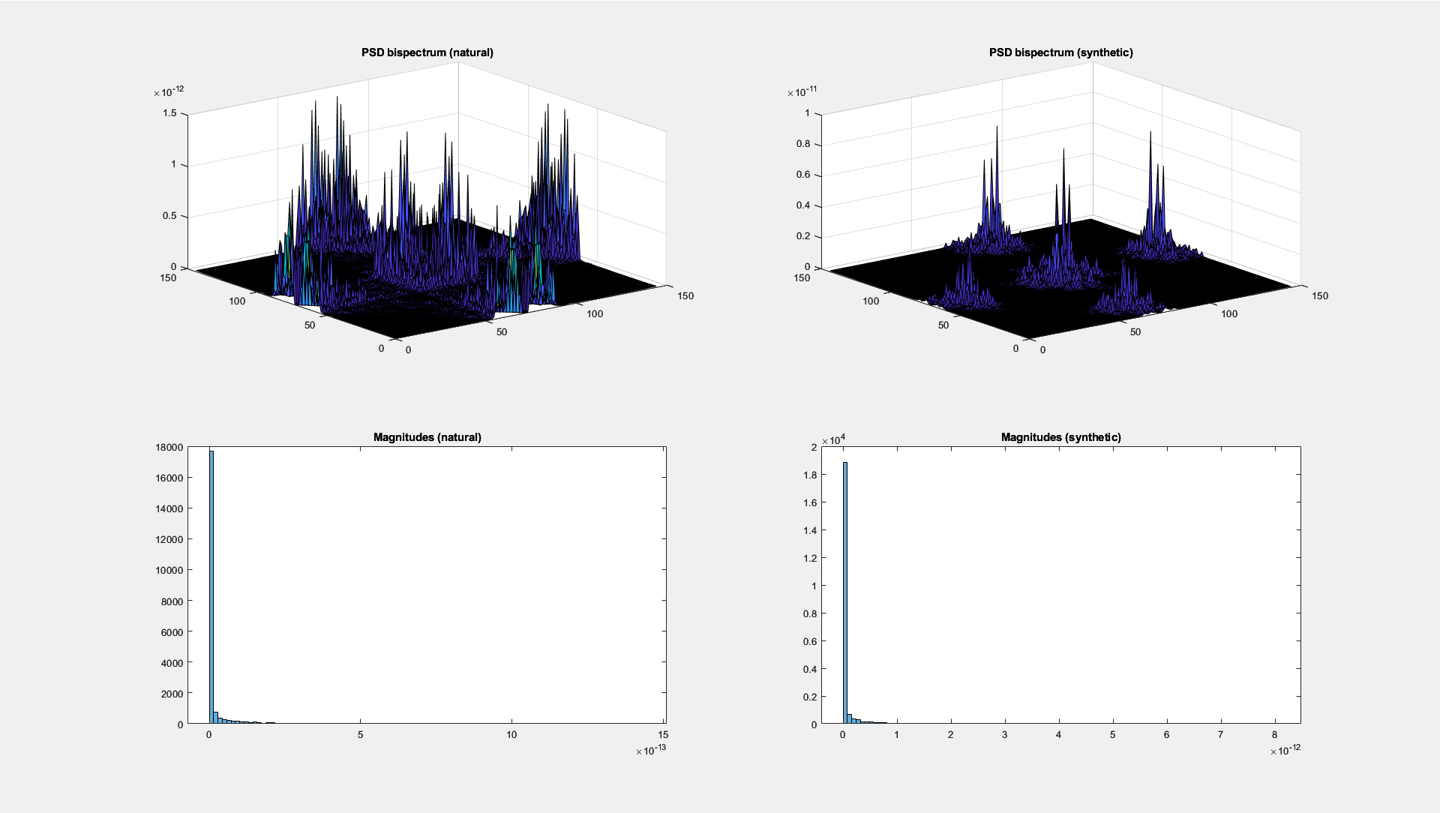

Slide 25
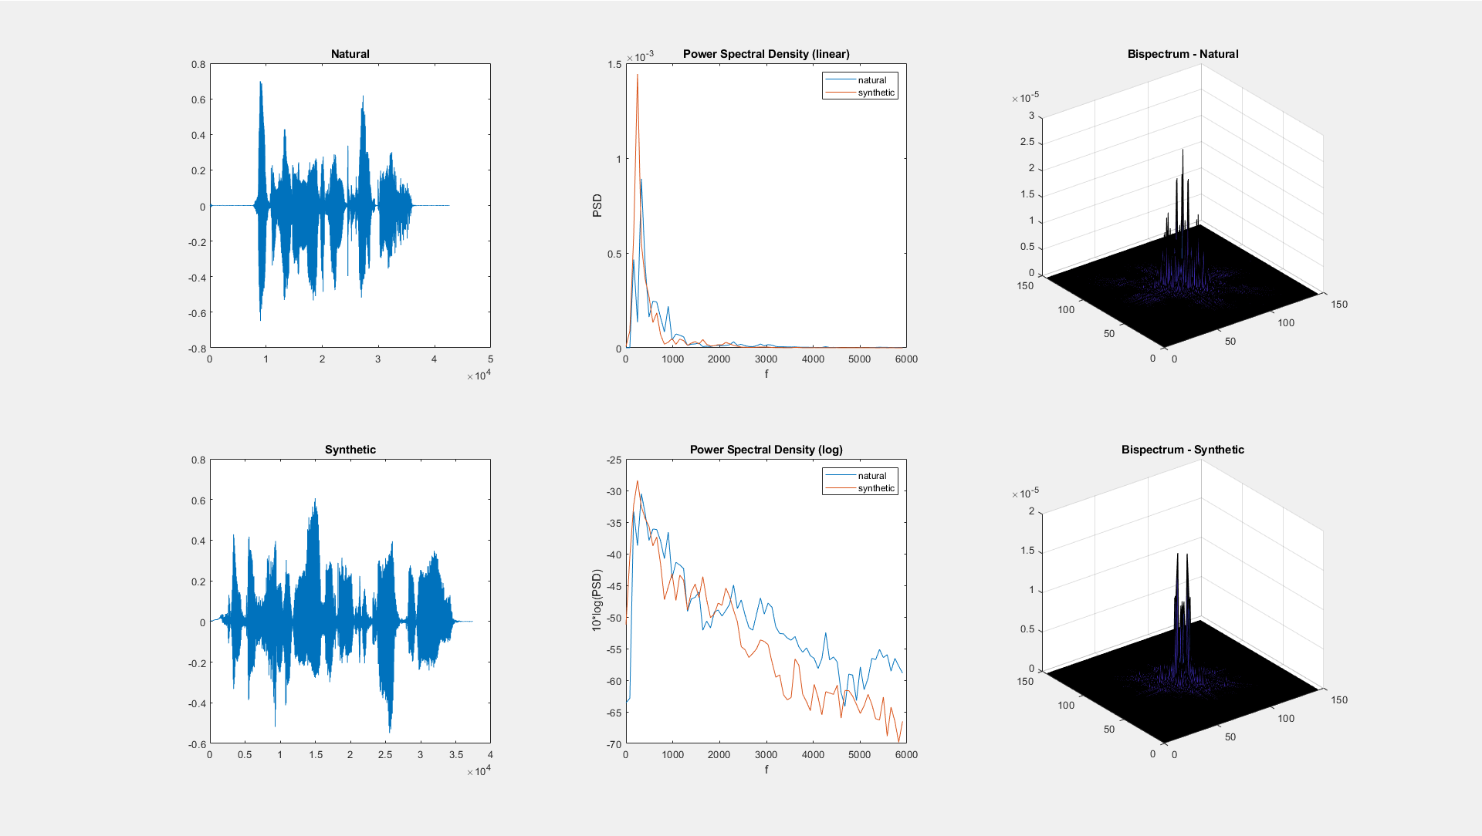

Slide 26
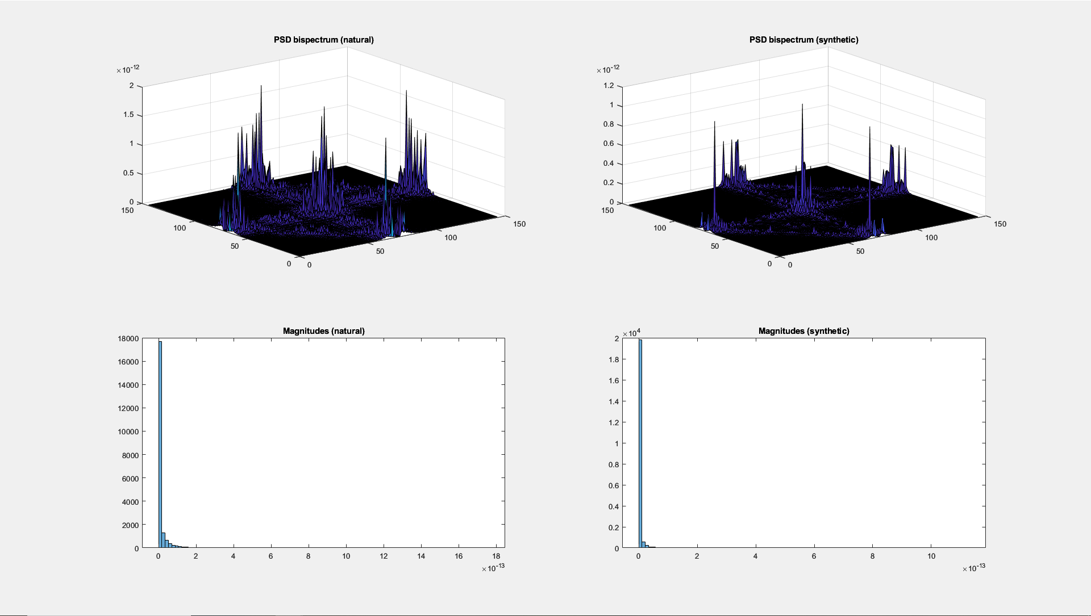

Slide 27
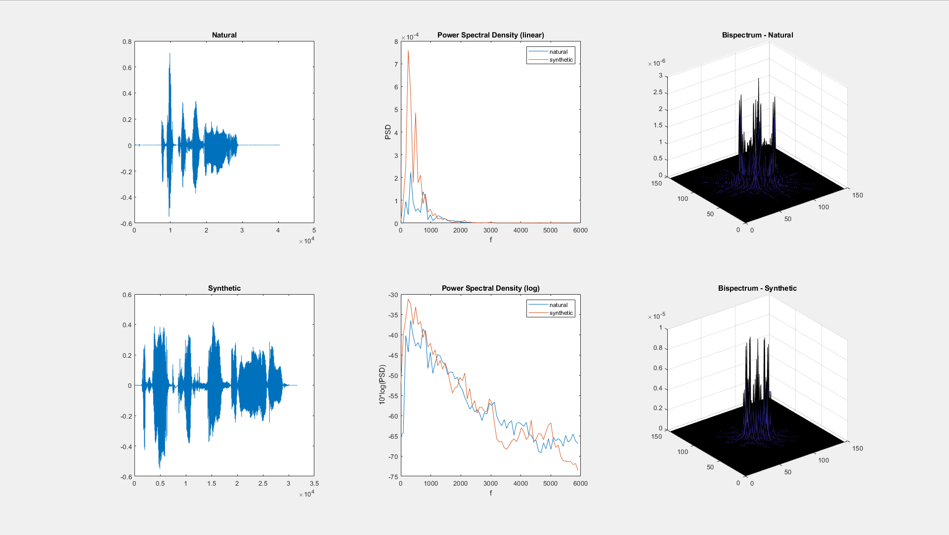

Slide 28
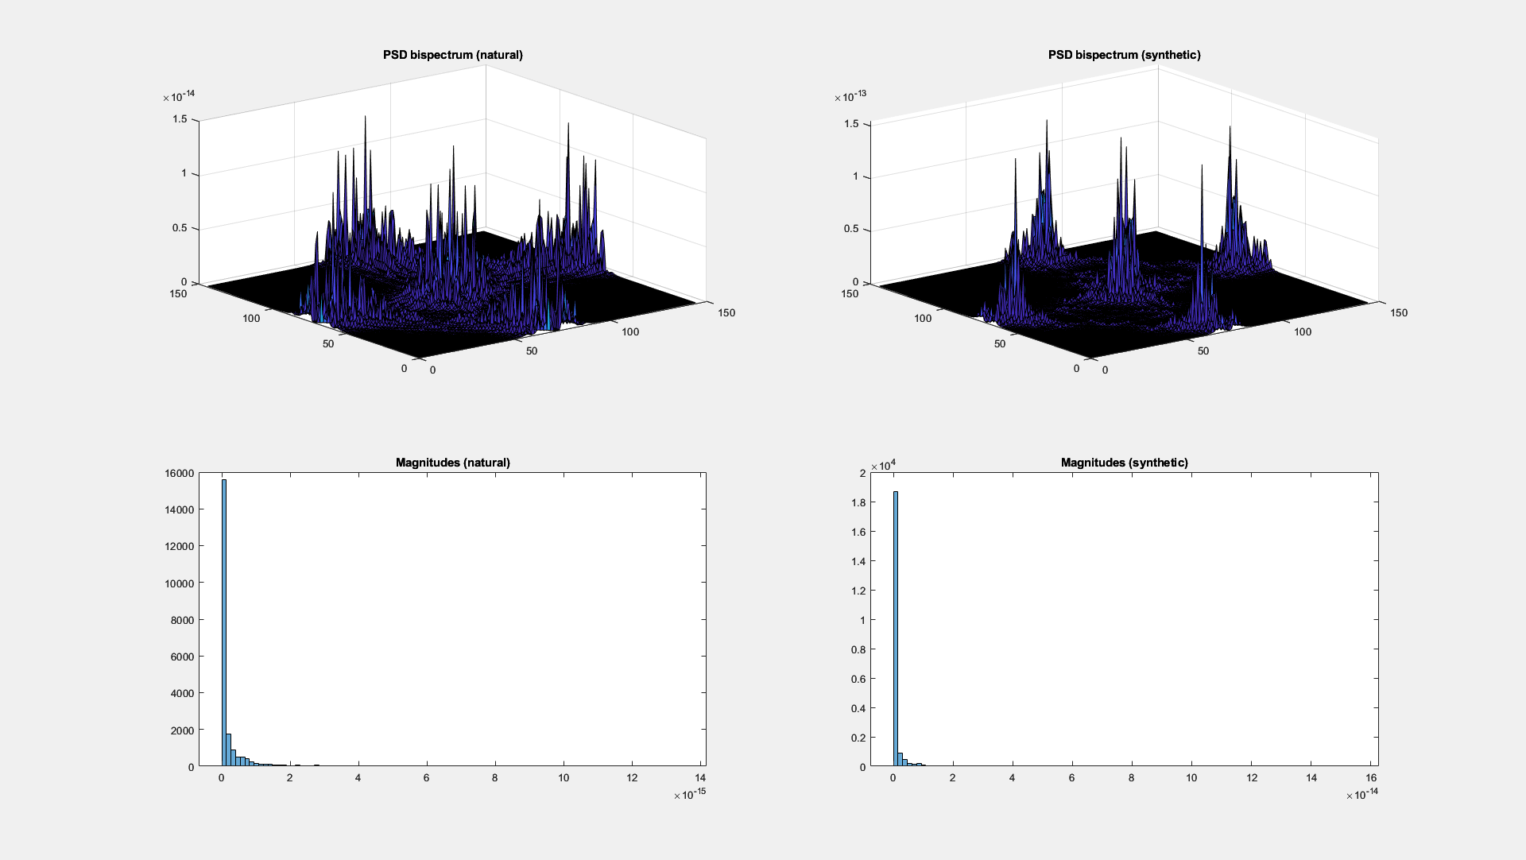

Slide 29
Observations
Most bispectum magnitudes are bigger for synthetic speech by a factor of around 10. Same for power bispectrum.
Power bispectrum magnitudes tend to have more spread for synthetic speech.
Possible horizontal shift in the power spectral density?
Male results are more consistent.

